Slide 1
Project Rifle
Improving targeting with meaningful quantitative analysis
Note: this is a subset of a longer presentation. Thank you to Bill Campbell & Tellme Networks for their fundamental contributions.

Slide 2
Inspiration
“If you don’t have any facts, we’ll just use my opinion.”
Jim Barksdale
“If we make the wrong decision, it’s your fault.”
Bill Campbell

Slide 3
What is Rifle?
Quantified decision making framework
  Provides a rigorous means of prioritizing among similar options
  Done well, leads to improved decisions that are broadly supported
Appropriate for major decisions
  In general involves 100+ hours of work & expensive resources per use

Slide 4
Rifle Improves Do-Or-Die Market Decisions
“Market Rifle” – what market segments should we be in?
  Intuition: focus on top 2,000 accounts; expand to complementary markets
  Rifle analysis: narrow focus to 30 of top 200; stay in core market for 2+ years
“Account Rifle” – which accounts should we target?
  Intuition: great financial services targets: [Company 1], [Company 2]
  Rifle analysis: none of the above are appropriate: better are [Com. 3], [Com. 4]
“Channel Rifle” – what channel strategy, what partners?
  Intuition: leverage large existing sales forces of channel partners to expand sales
  Rifle analysis: direct sales assisted by partners much more likely to succeed

Slide 5
Rifle In Action:
Market Strategy

Slide 6
Rifle In Practice:
Market Strategy Analysis
Establish clear alternatives
Establish targeting & prioritization framework
Get buy-in on the framework; know how it will be applied
Execute the analysis … and don’t screw it up!

Slide 7
Targeting the Right Market Segments:
Market Rifle Methodology Summary
Goal #1: market leadership
Goal #2: expand in a disciplined, highly leveraged way
Goal #3: identify & exploit network effects
Detailed Framework

Slide 8
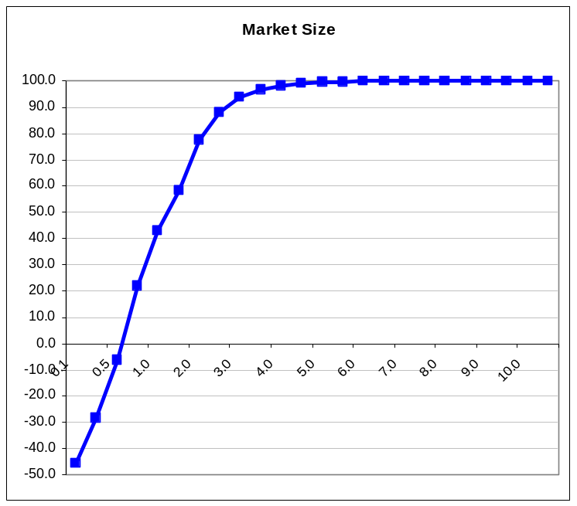
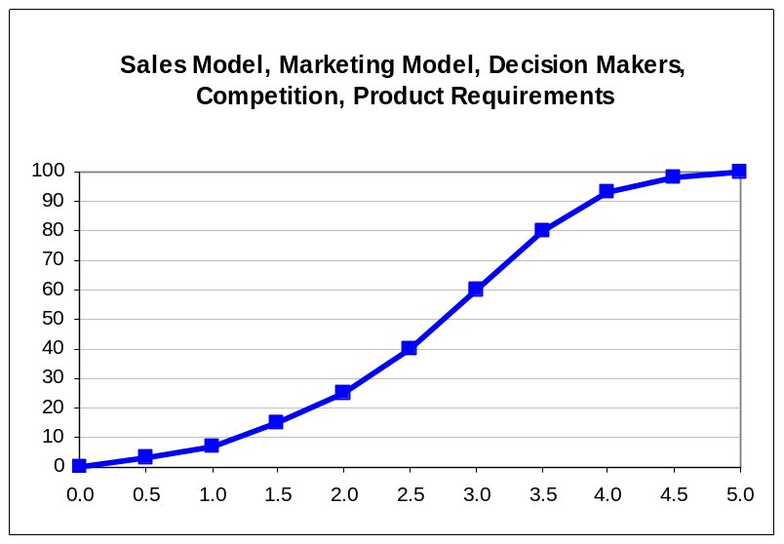
Quantitative Market Comparison:
“Rifle-izing” Key Characteristics
Evaluate and score each market on these 6 characteristics
Use simple 0-5 scale with typical “s-curve” value function for all characteristics (except “market size”, which is in $Bn)

Slide 9
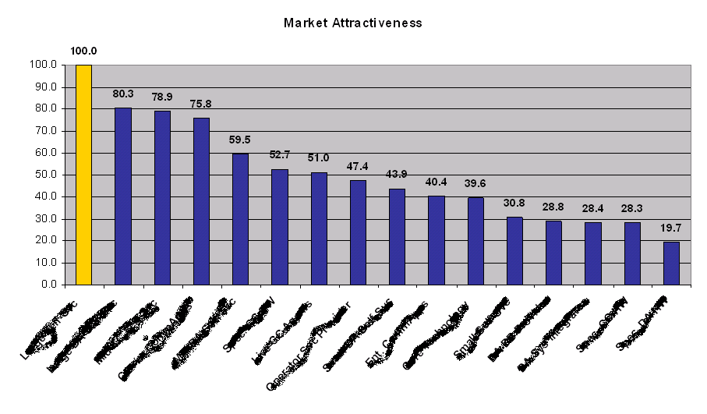
Expansion Strategy:
Market Rifle Given Current Data
Market Focus
<< Back

Slide 10
Rifle In Action:
Financial Services Segmentation & Targeting

Slide 11
Financial Services Market Analysis:
Huge Opportunity … Where to Focus?
100%
Total Market Potential
~$525M / yr
Market
Share
0%
0%
Industry Share
100%

Slide 12
Rifle In Practice:
Financial Services Market Analysis
Establish clear alternatives
  Which verticals (brokerage or credit cards?)…which accounts?
Establish targeting & prioritization framework
  13 carefully selected criteria based on win-loss analysis, customer interviews…
  Thoughtful weighting is as important as the criteria
Get buy-in on the framework; know how it will be applied
  Get buy-in on the framework before doing the analysis
  Application: A strategy presentation? Or ongoing process?
Execute the analysis … and don’t screw it up!
  Incorrect or misleading information is worse than nothing
  Getting good data requires creativity

Slide 13
Financial Services Market Analysis:
Huge Opportunity … Where to Focus?
100%
Total Market Potential
~$525M / yr
Market
Share
0%
0%
Industry Share
100%

Slide 14
Total Market Potential by Vertical:
Retail & Credit Cards Surprisingly Large
100%
Retail Banking
~$180M / yr
Credit and Charge Cards
~$215M / yr
Market
Share
Mortgage Credit ~$25M / yrs
Retail Brokerage ~$40M / yr
Investment Services ~$35M / yr
Life Insurance / Diversified Financial Services ~$30M / yr
0%
34%
41%
5%
7%
7%
6%
0%
Industry Share
100%

Slide 15
Financial Services After Rifle Criteria:
Target Universe Sharpens Considerably
Retail Banking
Credit and Charge Cards
Mort.
Credit
Retail
Brok.
Inv.
Svcs
Life Ins. /
Div. FS
100%
Too Small (3%)
Too Small (4%)
Other
(9%)
Small
(9%)
Recent IVR
Purchase (39%)
Recent IVR
Purchase (15%)
Small
(9%)
Other Telecom Network (41%)
OTN
(10%)c
Too Small (46%)
Recent IVR Purchase (50%)
Market
Share
Other Telecom Network (42%)
“Rifle” Life Insurance / Diversified Financial Services (91%)
14%
OTN
(11%)
“Rifle”
Credit and Charge
Card (40%)
“Rifle” Investment Services (73%)
OTN (36%)
“Rifle” RB
(17%)
“Rifle”
Retail Banking (14%)
0%
34%
41%
5%
7%
7%
6%
0%
Industry Share
100%

Slide 16
Post-Rifle:
Account Priority Becomes Clear
Retail Banking
Credit and Charge Cards
Retail
Brokerage
Investment
Services
Life Insurance /
Diversified Fin Svcs
100%
Company 1 (5%)
Company A (3%)
Com. AA (7%)
Company 11 (4%)
Company B (14%)
Company 12
(7%)
Company 2 (5%)
Company BB
(9%)
Company 13
(8%)
Company 3 (6%)
Company C (16%)
Company CC
(10%)
Company 14
(10%)
Company 4 (6%)
Com. #3
(17%)
Company 5 (10%)
Prudential
(11%)
Company 15
(11%)
Company D (16%)
Company 6 (13%)
Company #2
(17%)
Company
(18%)
Company 16
(14%)
Market
Share
Company E (22%)
Company 7
(35%)
Company AA
(45%)
Company 17
(18%)
Company F (30%)
Company 18
(30%)
Company #1 (50%)
0%
14%
47%
8%
14%
17%
0%
Industry Share
100%

Slide 17
Backup Slides

Slide 18
Rifle In Practice: Get Meaningful Data
Incorrect or misleading information is worse than nothing
  Don’t trade precision for correctness
  Analyst numbers can be useful, but often are wildly off
  Consider weighting data by confidence in source
  Don’t be seduced by large sample sizes
    20 random & representative inputs beats 2,000 biased ones
Getting good data requires creativity & persistence
  Extrapolate from high confidence, easy to find data
    Example: revenue opportunity by company
  Be creative in where to get the data
    Customers, potential customers, employees, former employees, advisors – network, network (remember, sometimes just 20 high quality responses are meaningful)
  Make it as easy as possible to gather clean data
    Beware leading questions, decouple weightings from data gathering
Back

